Slide 1

MMDE 11-150 Web Design
Lecture 9
→Multimedia Web -- Flash
Semester 102
Dr. James Birt

Slide 2
Outline
Web Multimedia
Behaviours – Dreamweaver
Flash

Slide 3
Web Multimedia
Web page interactivity includes:
Moving the mouse to make a new image appear
Clicking on radio buttons to take a survey
Click a product to watch a Flash movie about a company.
Adding the right touch can make a Webpage more engaging and compelling for your visitors.

Slide 4
Examples of Web Multimedia
Moodstream: Offers tools to adjust a stream of images, footage, & audio that can help inspire your creative direction.
Waterlife: A showcase for the documentary film of the same name that offers its audience a wonderful preview of the lush cinematography and rich storytelling found in the film.
MarcEcko: wonderful example of using the vast possibilities of Flash to accurately reflect the ethos of a consumer brand within a website.

Slide 5
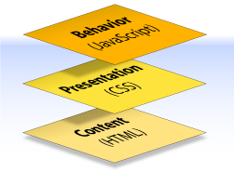
Week2 Revisit: 3-teired Architecture
A web document can consist of up to three layers—content, presentation & behaviour

Slide 6
Week2 Revisit: The Behaviour Layer
Involves real-time user interaction with the document
This task is normally handled by JavaScript but can also be done with other languages like PhP or ASP
The interaction can be anything from a trivial validation that ensures a required field is filled in before an order form can be submitted, to sophisticated web applications that work much like ordinary desktop programs reading and writing from databases etc

Slide 7
What is a Behavior?
A behavior is a combination of an event with an action triggered by that event.
Events are, messages generated indicating something has occured.
Different events are defined for different page elements.
An action consists of pre-written JavaScript code that performs a specific task.
For example, when a visitor moves the pointer over a link, the browser checks if there is Javascript for the onMouseOver event.
A single event can trigger several different actions, and you can specify the order in which those actions occur

Slide 8
Using Behaviors in Dreamweaver
Dreamweaver behaviors are prepackaged JavaScript programs that let you add interactivity to your Web pages with ease, even if you don’t know the first thing about JavaScript.
Behavior code is client-side JavaScript code; that is, it runs in browsers, not on servers.

Slide 9
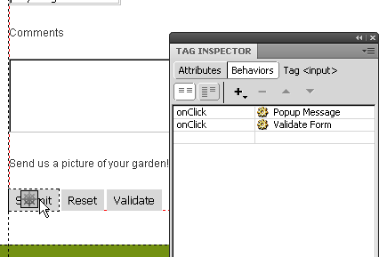
Understanding Dreamweaver Behaviors
By adding behaviors, you can:
• Make portions of a page appear and disappear.
• Open a new browser window to a specified size, with or without scroll bars, status bar, location bar, and other Web browser “chrome.”
• Change the background color of any element on a page.
• Pop open an alert box with an important message for your site’s visitors.

Slide 10
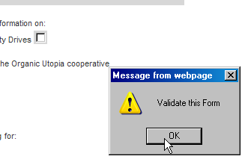
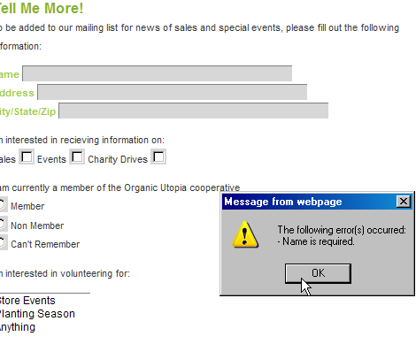
Understanding Behaviors
A behavior brings together three elements:
an action,
an event,
an HTML tag:

Slide 11
Plug Ins
Web browsers are designed to display Web pages, GIF, JPG and PNG images (among others)
When the media is not one of these types, the browser searches for a ‘plug-in’.
A plug-in can run directly in the browser window so that visitor can open objects directly within the Webpage.
Flash is an example where you are required to have a plug-in to play the content

Slide 12
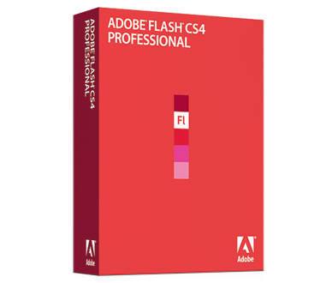
Introducing ADOBE FLASH CS4

Slide 13
What is Flash?
Adobe Flash, (or simply Flash), refers to both the Adobe Flash Player, and to the Adobe Flash Professional multimedia authoring program.
Flash is considered the authoring environment and Flash Player is the virtual machine used to run the Flash files, but in colloquial language these have become mixed: "Flash" can mean either the authoring environment, the player, or the application files.

Slide 14
What is Flash?
Since its introduction in 1996, Flash has become a popular method for adding animation and interactivity to web pages.
Flash is commonly used to create animation, advertisements, and various web page Flash components, to integrate video into web pages, and more recently, to develop rich Internet applications.
Notes:
Multimedia may be broadly divided into linear and non-linear categories. Linear active content progresses without any navigational control for the viewer such as a cinema presentation. Non-linear content offers user interactivity to control progress as used with a computer game or used in self-paced computer based training. Hypermedia is an example of non-linear content.
Multimedia presentations can be live or recorded. A recorded presentation may allow interactivity via a navigation system. A live multimedia presentation may allow interactivity via an interaction with the presenter or performer.

Slide 15
The Major Attributes of Flash
Until Flash came on the scene almost all web content was raster based, usually provided by Gif or Jpg file formats
Flash files are small.
Flash can incorporate:
Vector
Raster images
Audio files
Video files
Notes:
½ to ¼ of size of raster - and therefore animation files sizes are also small. Raster images have raster resolution. Use sparingly.

Slide 16
The Major Attributes of Flash
Scalability
Flash movies can be placed on a web site at any size without visual degradation or change to file size.
When designing a full screen Flash movie, concern over viewer resolution ( 800x 600 for example) is not as vital, you need only be concerned the aspect ratio is 4:3.
Once the Flash movie is created it can be defined at any physical size. ( as long as the aspect ratio is constant)

Slide 17
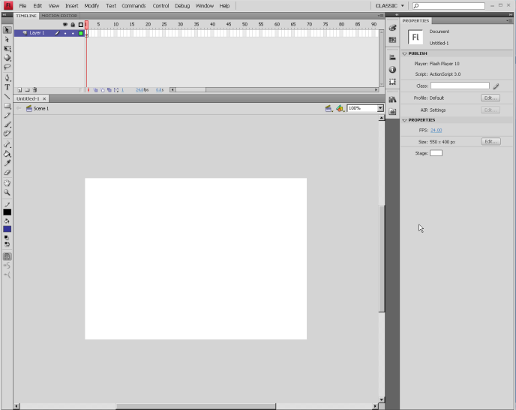
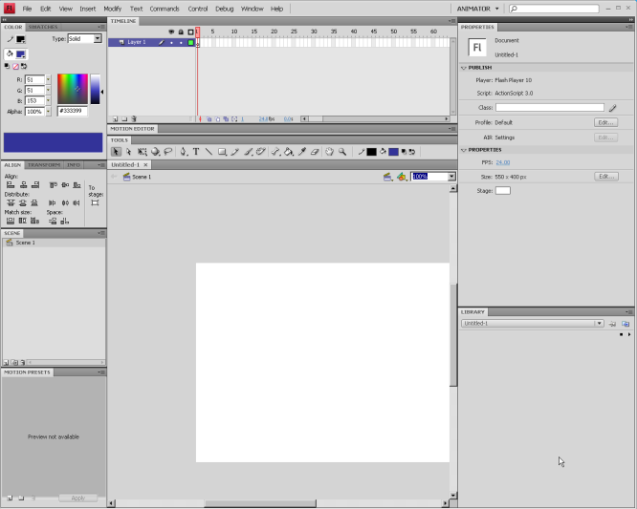
Key Features
Workflow
Flexible workspace
Shared libraries
Native support for OS X and XP
Flash file format .fla
Flash movie format .swf

Slide 18
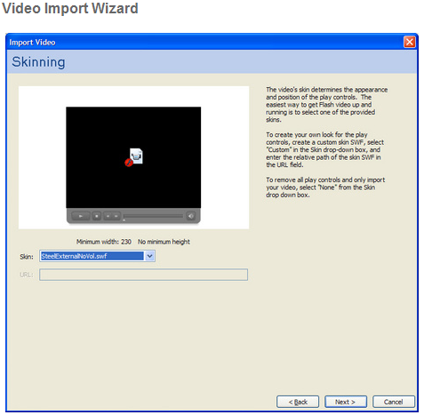
Key Features
Rich media support
Video support
Dynamic loading at runtime
High- fidelity audio support
.avi (Audio Video Interleaved).
.dv (Digital Video)
.mpg or mpeg (Motion Picture Experts group)
.mov (QuickTime Video)
Notes:
it only loads the movies the site needs when they're needed -so no unnecessary downloads
Flash isn’t always friendly to video – but getting better with each version-mainly because it was designed as a low bandwidth web based system... and video is by its very nature large files and high bandwidth

Slide 19
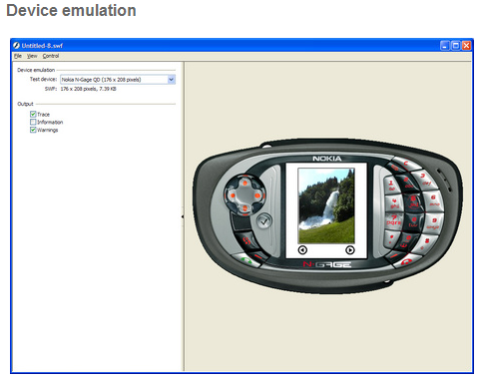
Key Features
Publishing and playback
Design for multiple mediums
Named anchors
Web native printing
Multiple file format export
Enhanced compression

Slide 20
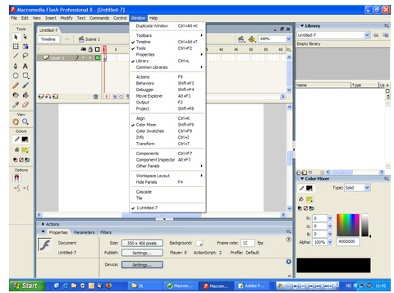
Key Features
Document tab
Toolbar
Timeline
Stage
Panels
Properties

Slide 21
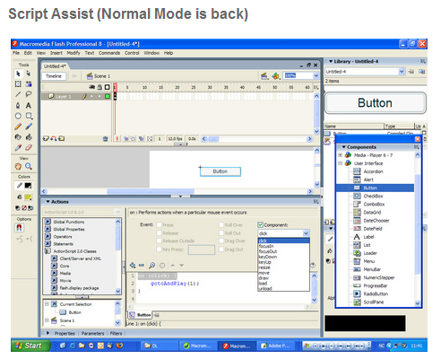
Key Features
ActionScript editor
Enhanced for novice and expert users
Customizable
Code hinting and completion
Debugger
ActionScript reference panel

Slide 22
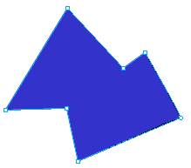
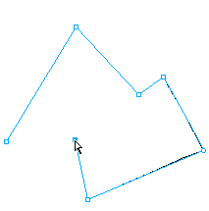
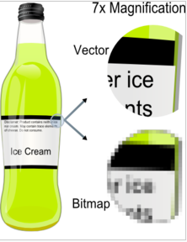
Vector vs. Raster/ Bitmap
Flash can manipulate vector and raster graphics, and supports bidirectional streaming of audio and video.
Vector:
based on mathematical equations, to represent images in computer graphics. Made up of points, lines, curves, and shapes or polygon(s).

Slide 23
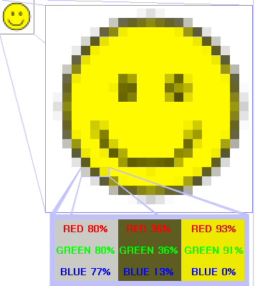
Vector vs. Raster/ Bitmap
A raster image or bitmap is a data structure representing a grid of pixels, or points of color, viewable via a monitor, paper, or other display medium.
Characterized by the width and height of the image in pixels and by the number of bits per pixel (a color depth, which determines the number of colors it can represent).

Slide 24
Action Script
Flash uses a scripting language called Action Script – Current Version is Action Script 3
Used to control animation, video and audio applications
Some common AS3 scripts you might want to try:
stop(); Stop the action playback on that keyframe
play(); Continue the playback from that position
gotoAndStop(); and gotoAndPlay(); jump to a specific frame then stop or play
E.g. gotoAndStop(5); would go to frame five and stop the play you would then require a play(); on that frame to start the action

Slide 25
FLASH ANIMATION
The Basics

Slide 26
Flash Animation
Overview
Flash allows you to create projects called movies.
Flash can create all the objects you need for an animation in Flash or import from other compatible software (Such as Adobe Photoshop, Illustrator etc)

Slide 27
Flash Animation
A movie is much like what you go to see in a movie theatre. It is composed of one or more scenes.
A scene can be considered a small, self-contained movie and is comparable to a chapter in a book.

Slide 28
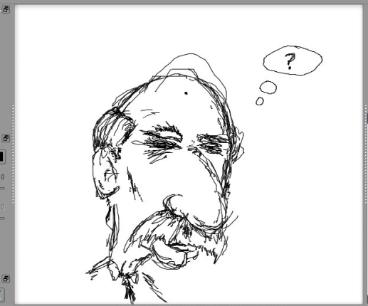
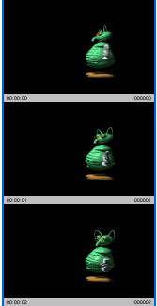
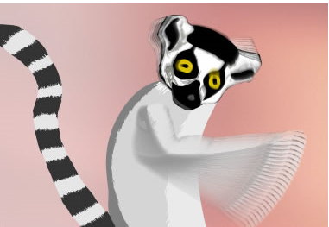
Flash Animation – Frames
Each scene consists of several frames.
A frame is one single picture within a scene.
Playing frames in rapid succession gives the human eye the illusion of constant motion.

Slide 29
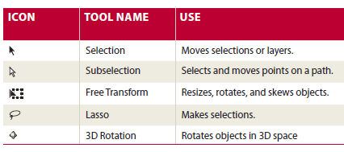
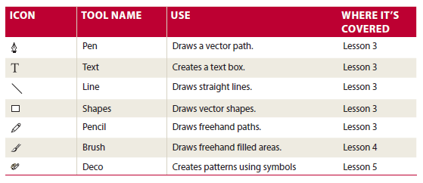
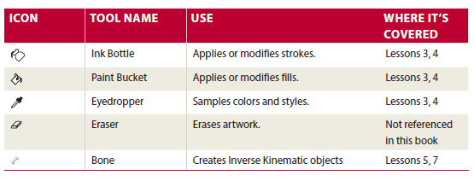
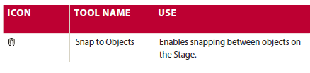
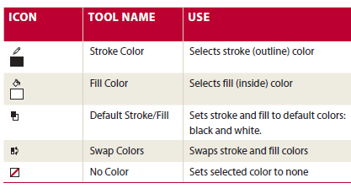
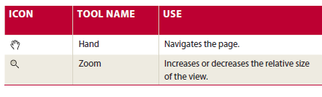
Flash Tools

Slide 30
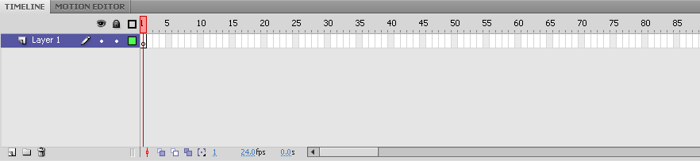
Flash Animation – Timeline
The amount of time your movie is showing depends on the total number of frames you define.
The timeline shows the structure of the working area and is divided into sections of frames measured in fps

Slide 31
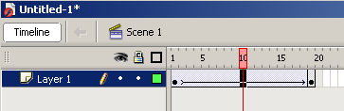
Keyframes
A keyframe is a frame where the action of your object changes significantly.

Slide 32
Flash Animation - Timeline
Each section is started by a keyframe.
A section can be as long as you want, and whatever is in the section's keyframe will remain onscreen until the next keyframe.
The light red rectangle with a vertical line underneath is the playhead.

Slide 33
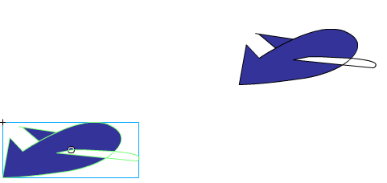
Flash Animation
Example: a plane flies across the screen from left to right.
Keyframe 1 in this case would be the frame where the plane starts on the left side of the screen, keyframe 2 in this case would be the frame where the plane stops on the right of the screen.

Slide 34
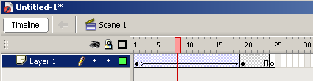
Flash Animation - Playhead
The screen (or stage) displays the contents of whatever frame the playhead is on.
So, if you wanted to add something to the blank keyframe in the timeline, you would drag the playhead anywhere in that section, and add your content to the stage.

Slide 35
Flash Animation - Tweens
To animate an object, you define two or more keyframes (frames where the action changes significantly).
Between those keyframes are several frames which show the transition between those keyframes.
This transition can be generated using Flash.

Slide 36
Flash Animation - Tweens
The process of transition is called tweening.
Tweening is a Flash function which determines the best way to transfer an object from one keyframe to the next.

Slide 37
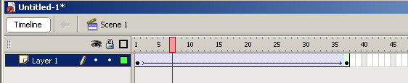
Flash Animation - Tweens
There are actually two types of tweens with different limitations:
Motion tweens
A circle moving from the left to the right. This is a motion tween

Slide 38
Shape Tween
Shape tweens: The transition of a square-to-circle sequence is a shape tween.

Slide 39
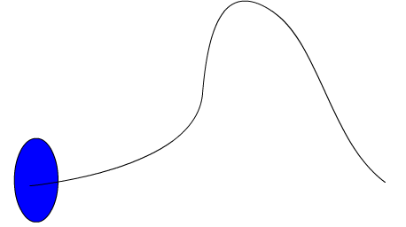
Motion Guide Tween
A third animation is a variant of the motion tween i.e. a circle moving in a curved path. This is a motion tween with a motion guide.

Slide 40
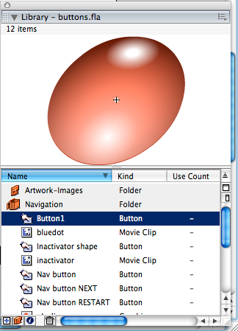
Flash Animation - Symbols
The objects created must be saved as a symbol.
Symbols are those objects which make up your scene.
Symbols are objects that are stored in your movie's library for reuse.
Symbols can easily be reused and/or modified.
Symbols can be added to the library by the user.

Slide 41
Flash Animation - Symbols
Movie Clip
Most common type of symbol and also most useful. For reusable pieces of animation. You can make mini-movies within a main movie. You can also use a movie clip for static images or text.
Button
To create interactive buttons that respond to mouse clicks, rollovers or other actions. Definition is applied to the various states i.e.: up, over, down, and hit.

Slide 42
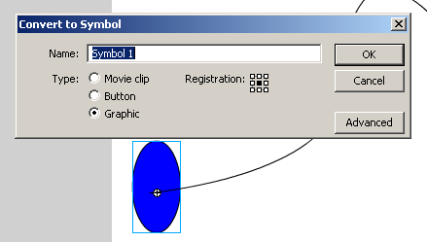
Flash Animation–Symbols
Graphic
The simplest form of symbols, but the least flexible.
Graphic symbols cannot be controlled through ActionScript.
Use for static images and reusable pieces of animation that are tied to the timeline.
Interactive controls and sounds won’t work in a graphic symbol's animation sequence

Slide 43
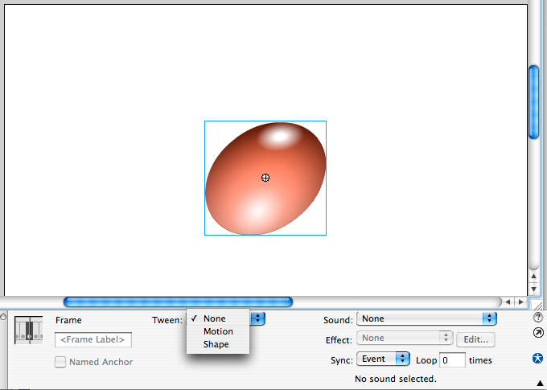
Flash Animation – Instance
When you use transformations like scale, rotate, or transparency on the stage, the symbol you have stored in the library doesn't change - just the individual copy, called an instance, you're applying it to

Slide 44
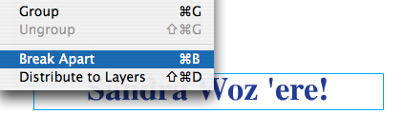

Flash Animation - Text
Tweening Text
If you want to morph text, you'll have to select the text and press Modify > Break Apart.
This will separate the text into individual letters which can still be edited
1.
2.

Slide 45

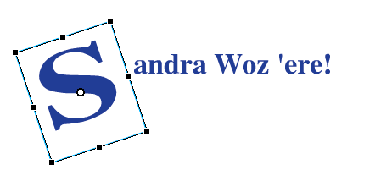
Flash Animation - Text
3.
4.
If you want to avoid font replacement of your text, you'll have to select the text and press Modify > Break Apart again to create a graphic of the text.
Flash will then treat the text as shapes instead of text. (Which means you can't edit the text anymore.)

Slide 46
Flash Animation - GIFs
Animated GIFs
You can export your movies as animated GIFs.
The one real advantage GIFs have over Flash files is that just about every web browser can display GIFs—Flash movies require the Flash Player plugin. (Most people have it, but not everyone.)

Slide 47
Flash Animation - GIFs
Remember, each frame of an animated GIF could be several kilobytes in size—a 2 second move at 12 fps could be as big as 80 kb. A Flash movie would be about 1kb
Animation below about 15 fps will look choppy*

Slide 48
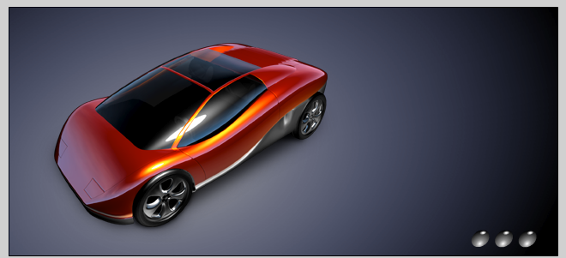
Flash Animation Vector/Bitmap
Bitmap/Raster images
Sometimes bitmaps are necessary, most raster file types are able to be imported into Flash
Take care using photographs as vector artwork

Slide 49
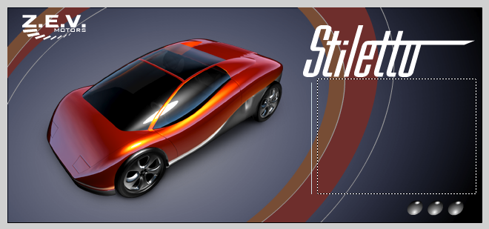
Flash Animation Vector/Bitmap
Bitmap/Raster and Vector images
Sometimes a combination of both is required to achieve the best result!

Slide 50
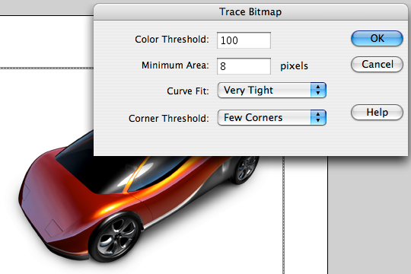
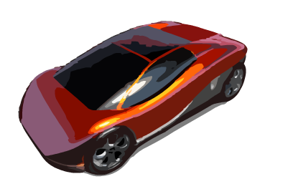
Flash Animation -Vector-Bitmap
Conversion of Bitmaps to Vector using the Trace Bitmap feature can give erratic results.

Slide 51
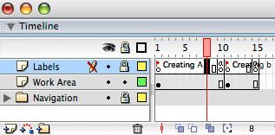
Flash Animation - Layers
In addition to frames, each scene can be made of different layers.
Place each object on a separate layer. This practice will make manipulating (animating) your objects much easier.
Notes:
To understand the concept of layers, think of a stack of transparencies. You can place different objects of your scene on separate transparencies (layers). To see the complete scene, you would then look at all the transparencies together stacked up.

Slide 52
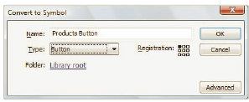
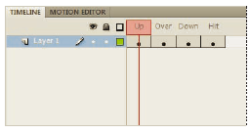
Buttons
Buttons are one of three symbol types in Flash, and, like all symbols, they live in the library
Buttons are designed specifically to react to the user’s mouse and keyboard actions.
Like other symbol instances, each button instance can have its own transformation and colour characteristics.
In addition, button symbols can also have filter effects applied from the Property Inspector, and be assigned instance names for ActionScript control

Slide 53
Actionscript on Buttons
Make your button → Add to canvas
Instance name your button e.g. myButton
Add actionscript for that button
Add event listener
Write function
Example: write a function to call a URL
myButton.addEventListener(MouseEvent.CLICK, callURL);
function callURL(event:MouseEvent){
var request:URLRequest = new URLRequest("http://www...");
navigateToURL(request);
}

